Slide 1
February 2022
A New Global ERA For
Communication
Professionals

Slide 2
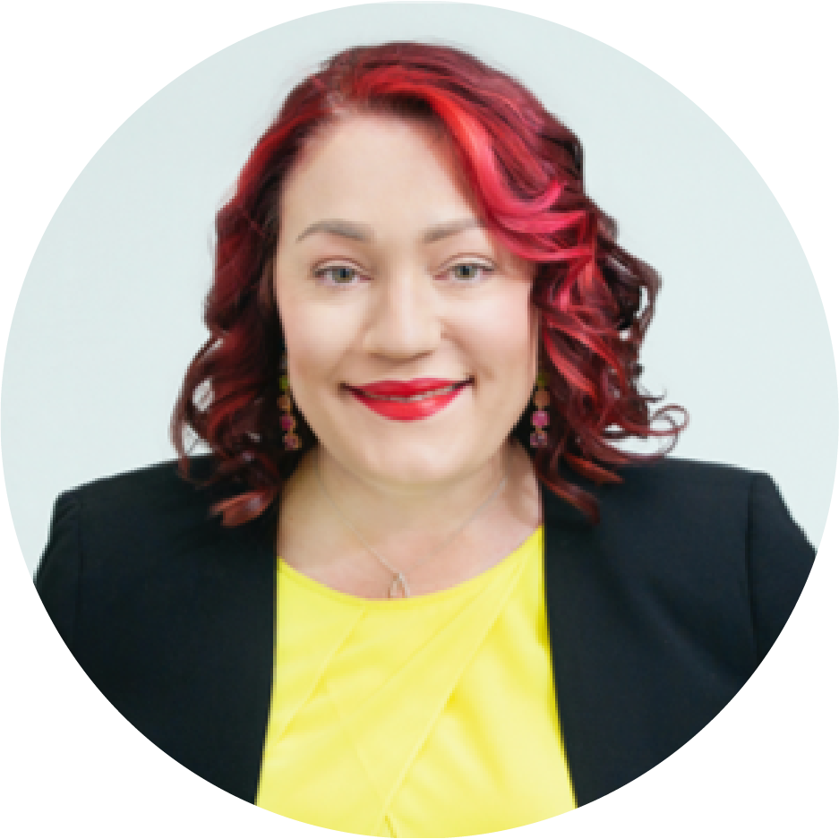
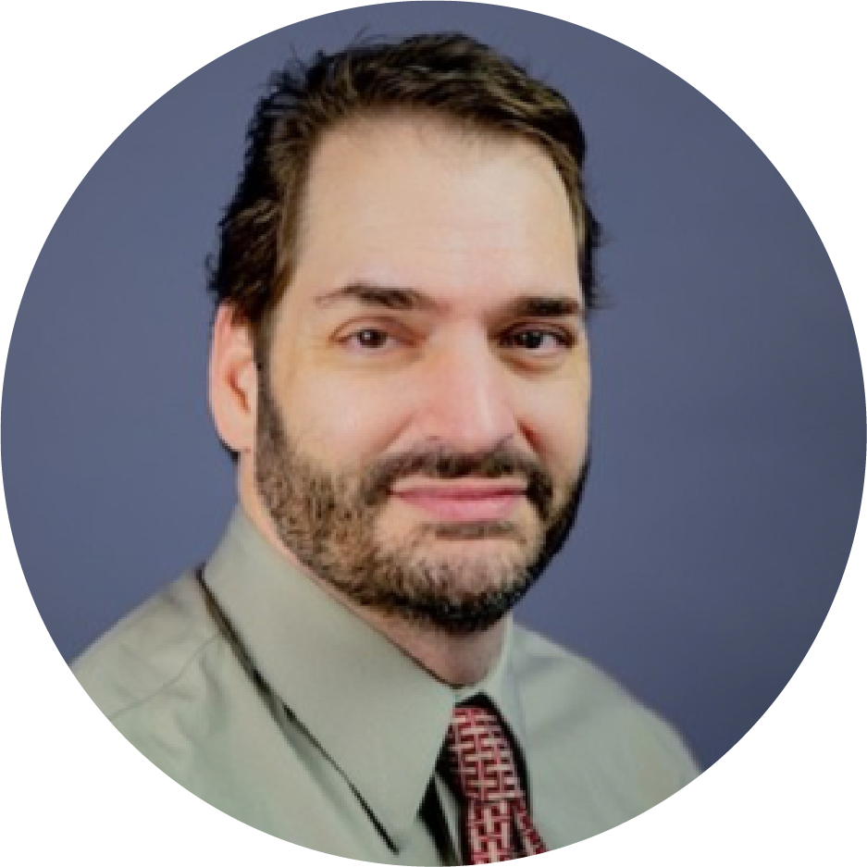
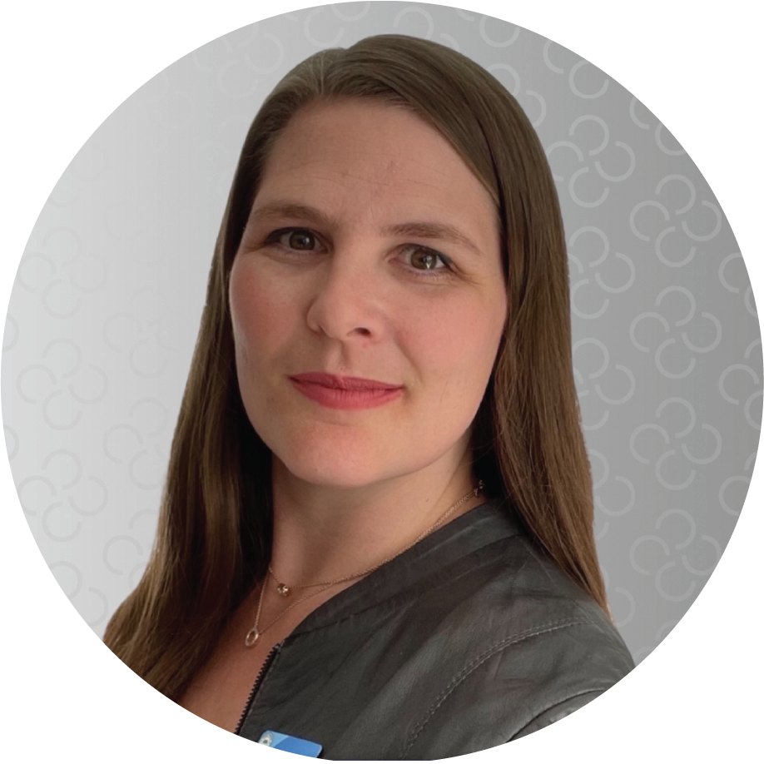
Your hosts
Sia Papageorgiou FRSA, SCMP
Mark Evans SCMP
Nekolina Lau SCMP

Slide 3
What we’re going to cover today
How we’re listening to what candidates want
Live online proctoring of exams
More equitable access to certification
Our new value proposition
Let’s share ideas
Your questions answered

Slide 4
We’re listening
Now is
the time.

Slide 5
A few things we’ve been working on
Greater engagement with current and prospective certificants
Updated renewal rubric and measuring renewal satisfaction
Career planning guide for prospective candidates

Slide 6
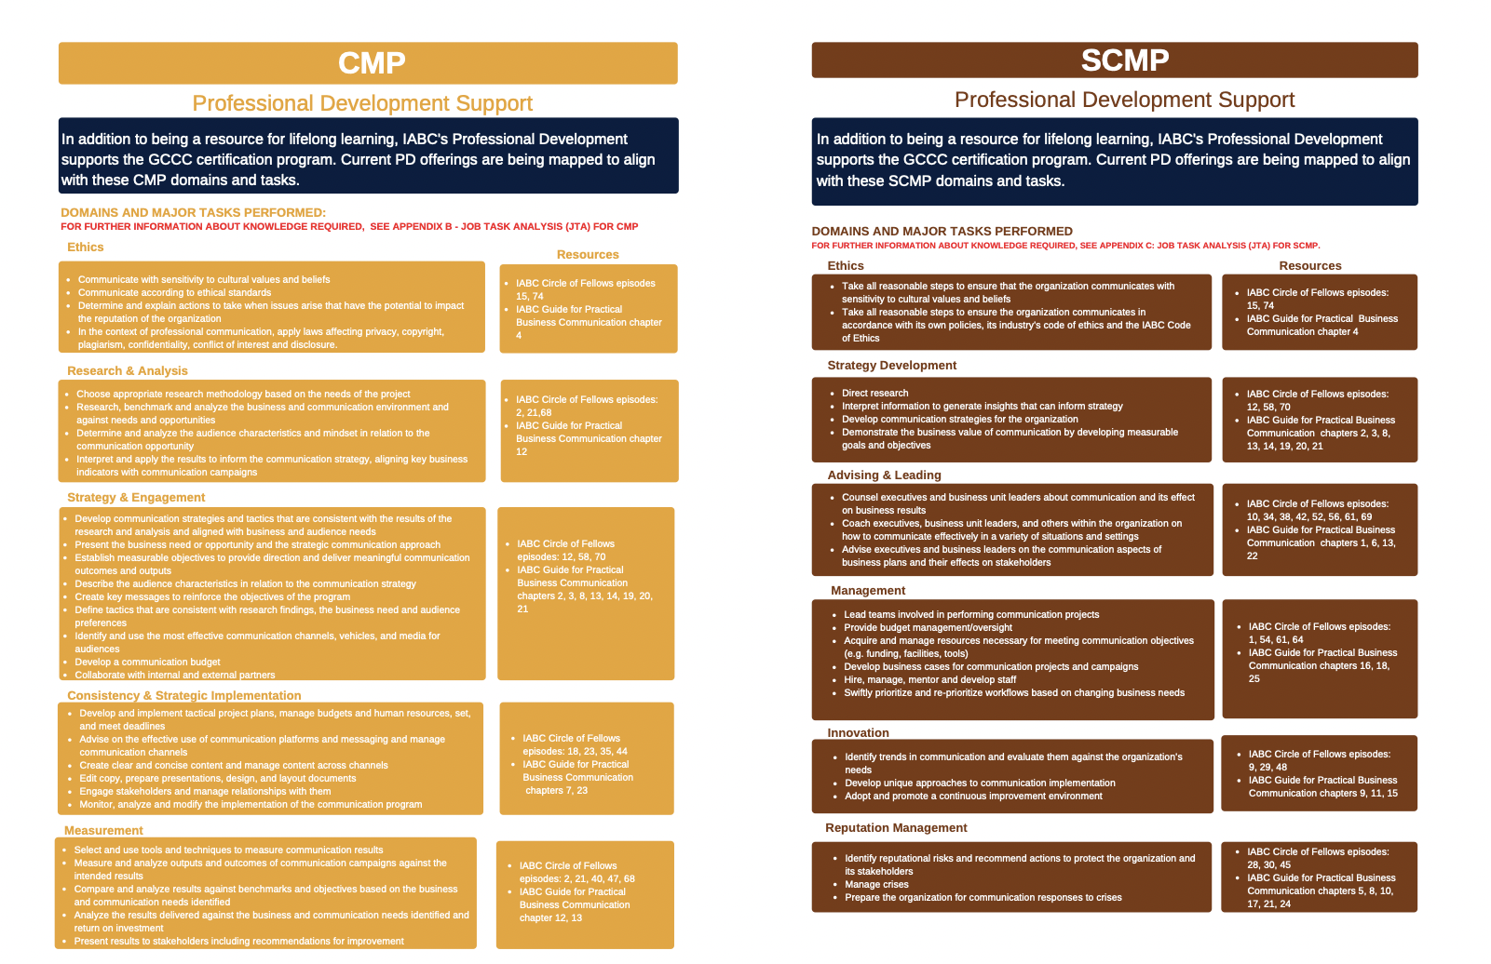

Slide 7
Do it your way
Anywhere.
Anytime.

Slide 8


Slide 9
What else?
More equitable access to certification
Use certification to encourage new members to join IABC

Slide 10
A new global ERA
Your gateway
to thrive.

Slide 11
Excellence
The Global Standard of the Communication Profession is defined and supported by communication professionals from around the world.

Slide 12
Recognition
ISO standards are recognized everywhere.
The GCCC was established to create and maintain an internationally recognized standard of communication excellence.

Slide 13
Advancement
GCCC certification opens new avenues at different stages of career development around the world.

Slide 14
Brainstorming discussion
How can you create a certification strategy in your chapter/region that focuses on excellence, recognition, advancement?
What’s working right now?
Any great ideas you want to share?
How can IABC/GCCC help?

Slide 15
Q&A

Slide 16
We’re here to help
Sia Papageorgiou FRSA, SCMP sia@thecsce.com
Mark Evans SCMP markevanstx@gmail.com
Nekolina Lau SCMP nlau@atb.com
GCCC website: gcccouncil.org
Email: info@gcccouncil.org

Slide 17
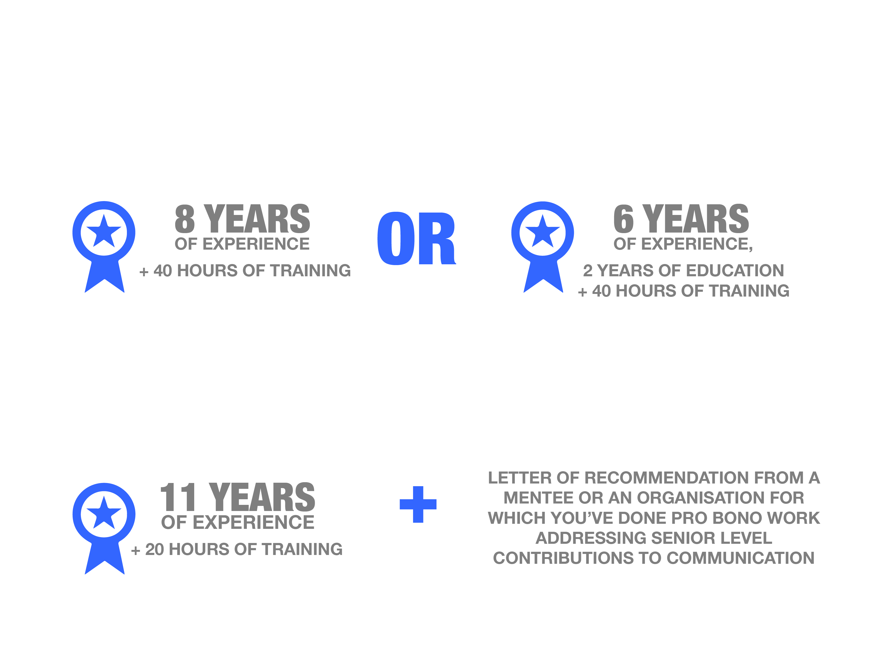
What certifications are available?
Communication Management Professional (CMP) established in your career as a communication manager and looking to demonstrate your competence.
You need:
Strategic Communication Management Professional (SCMP) highly skilled and practiced in providing strategic communication advice and counselling to your organisation’s leadership.
You need:

Slide 18
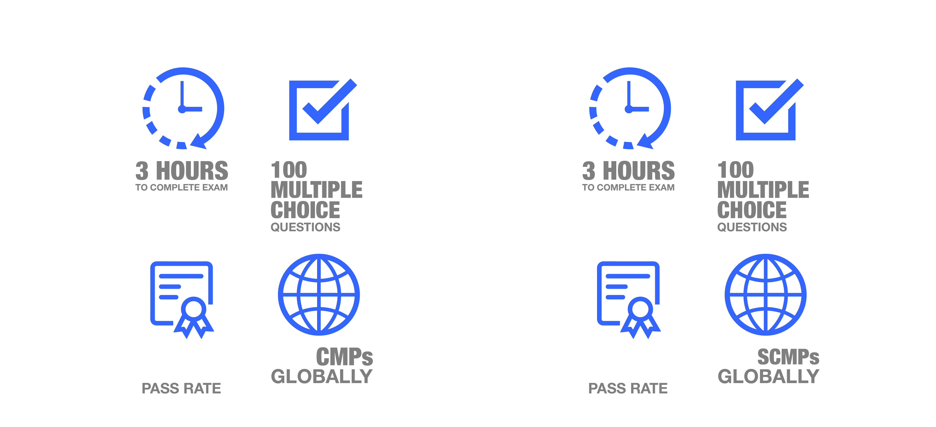
CMP: By the numbers
SCMP: By the numbers
66%
141
88%
131

Slide 19
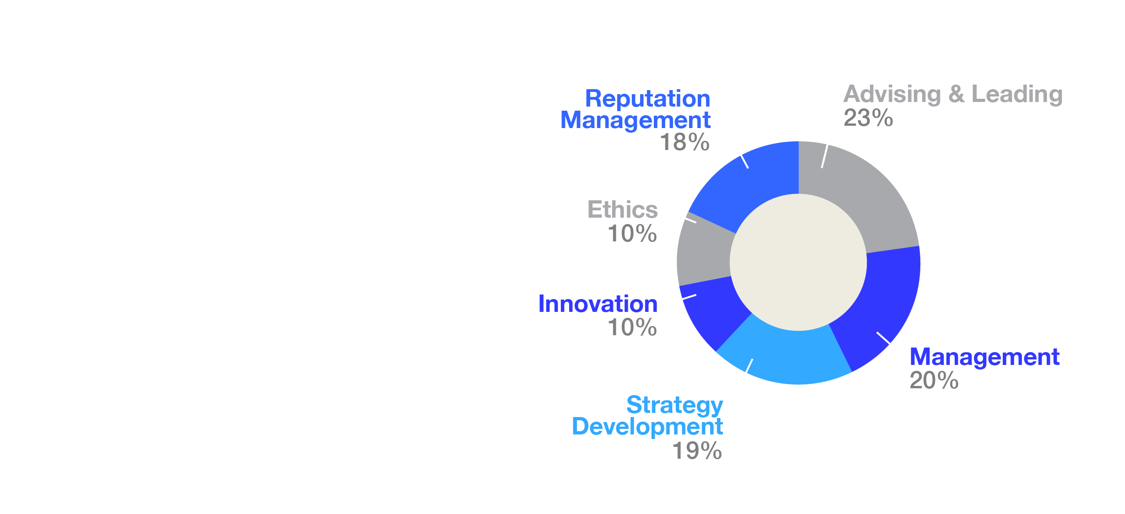
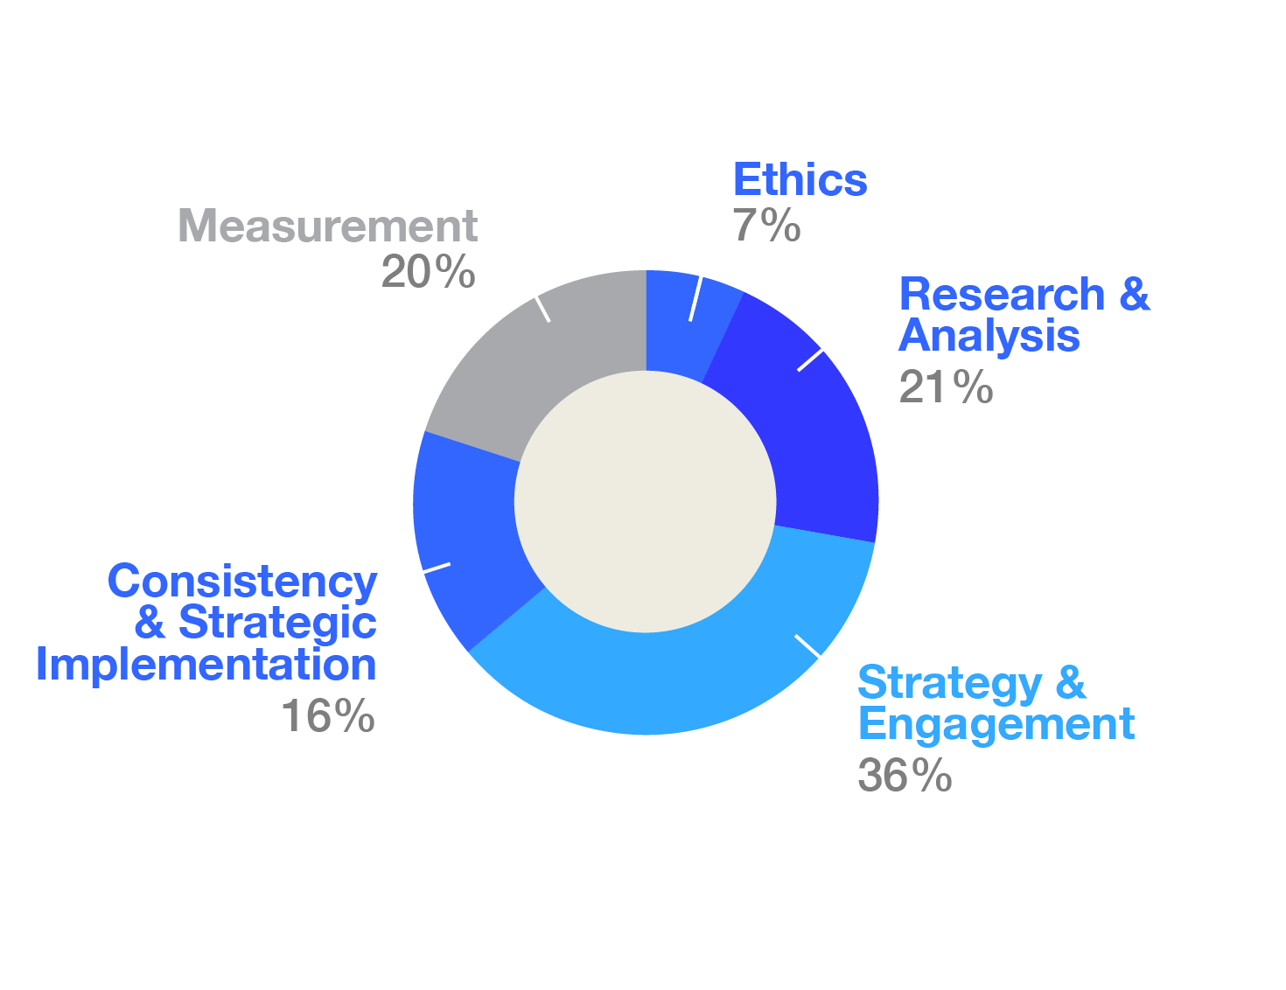
What are you measured against: CMP
What are you measured against: SCMP

Slide 20
What happens once you’re certified?
You must earn 40 professional development (PD) points per year to maintain your certification.
Complete your renewal application and pay the annual fee.

