Slide 1
Creating Community in a Time of Uncertainty
Volunteer recruitment, engagement and succession planning

Slide 2
Agenda
Building community Recruiting Onboarding | Retention Succession Planning Breakout rooms & chat
Notes:
AG - to cover

Slide 4
It’s Our Job to Facilitate the Bonds
Portfolio teams
Cross-portfolio teams
Other chapters
Members
Sponsors and partners
...and with each other

Slide 5
How can you build trust within your teams?
Notes:
Breakout room discussion - 7 minutes + 5 minute discussion

Slide 6
Volunteer Recruitment

Slide 7
Finding the right volunteer
Connect via phone/Zoom call to learn about potential volunteers’ skills and interests
Stay flexible while matching skills to roles
Keep the experience short, easy and simple

Slide 10
Board Recruitment

Slide 13
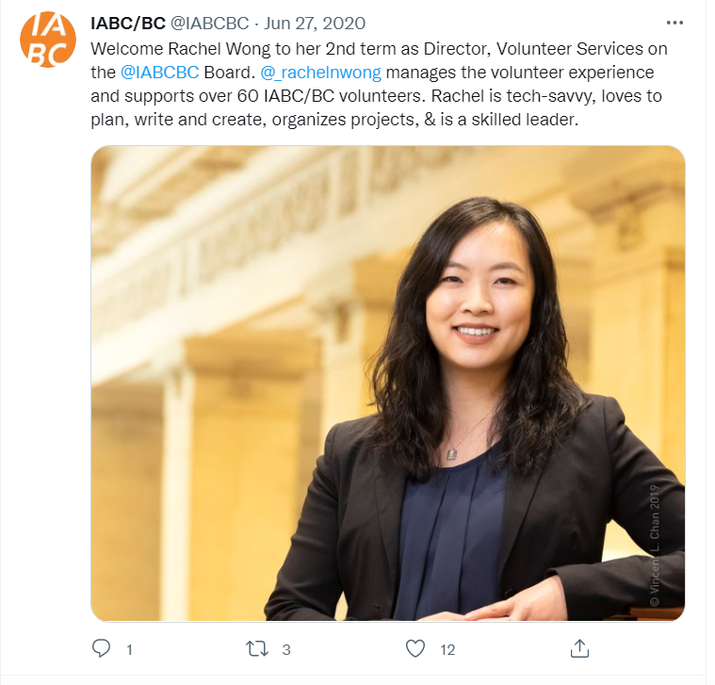

Slide 14
Onboarding

Slide 15
Simplify the onboarding process for volunteers
Streamlined onboarding processes
Introduction to collaboration platform, Basecamp
Welcome message for all incoming volunteers on Basecamp
Set every volunteer up for success!

Slide 16
Volunteer Professional Development Series

Slide 17
Check-ins with volunteers

Slide 18
One month
Three month/Mid-year
End of term
After a month, we reach out to volunteer and director separately to see how things are going
An opportunity for directors to evaluate how things are going with their volunteer team
Celebrate successes and thank the volunteer for their work
Discuss and confirm that volunteer experience was met

Slide 19
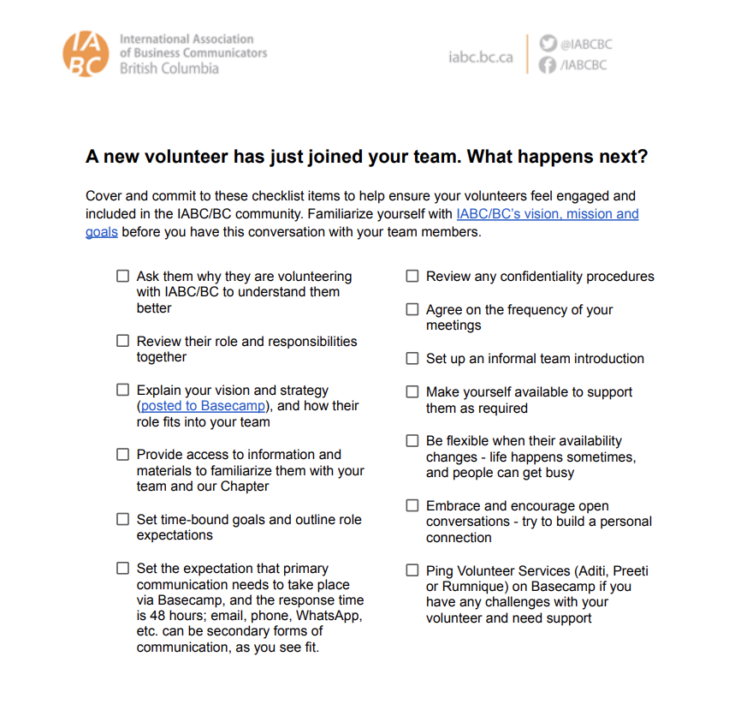
Volunteer Onboarding Essentials toolkit for directors
Handy information and resources
Tips on how to connect with volunteers - as professionals and on a human level

Slide 20
IABC 101 Platform
Format: Built for IABC Academy using LearnUpon
Purpose: Give new Board leaders the tools & knowledge they need to thrive
Goal: Increase leaders’ confidence in their abilities

Slide 21
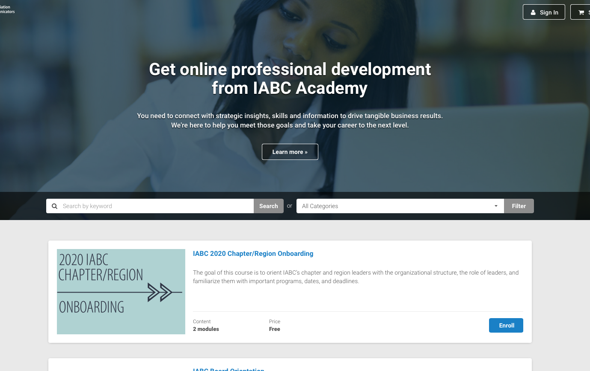
WHO:
New board members
WHAT:
A course to provide a comprehensive and interactive onboarding experience for the IABC/BC board
WHEN:
Delivered when new board members are confirmed
WHERE:
Created & hosted on IABC Academy (back end: LearnUpon)
WHY:
To increase new board members’ confidence as they enter their term

Slide 22
Philosophy
Don’t tell them everything they’ll ever need to know. Provide just the right educational content to get them on their way successfully.
Why?
Too much detail > overwhelm > disengaged out for rest of course
Course is complemented by board strat planning, Dare to Lead & more

Slide 23
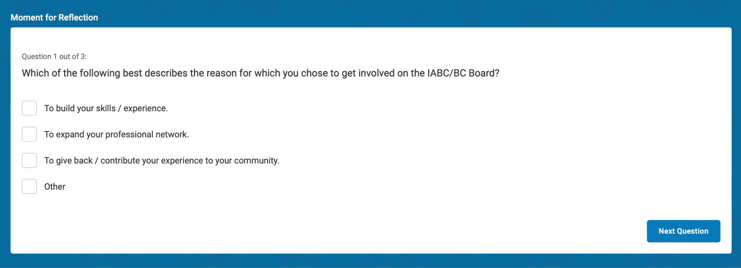

Slide 24
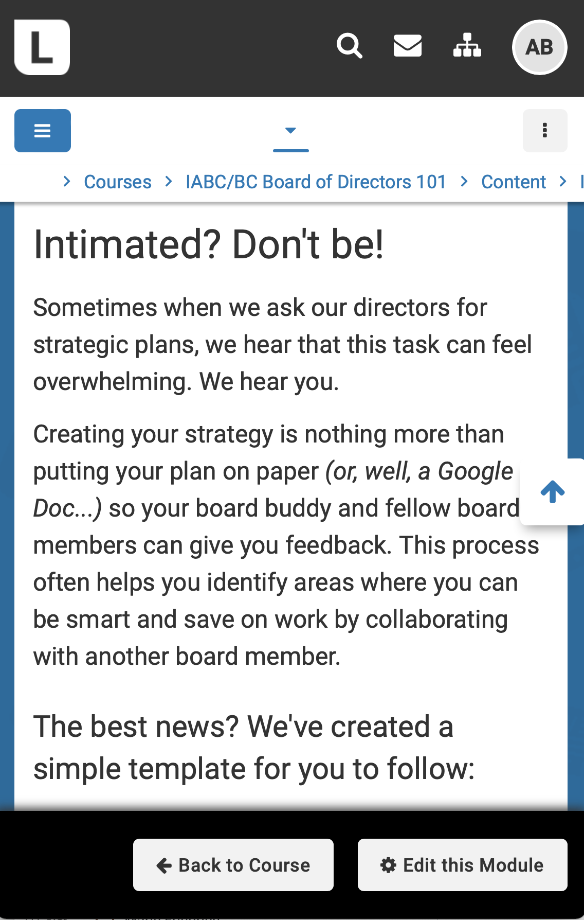
This course should inform, engage and instill confidence. A formal tone isn’t the right approach.
The voice will be conversational, and content will be delivered in a personal tone.
VOICE
& TONE:

Slide 25
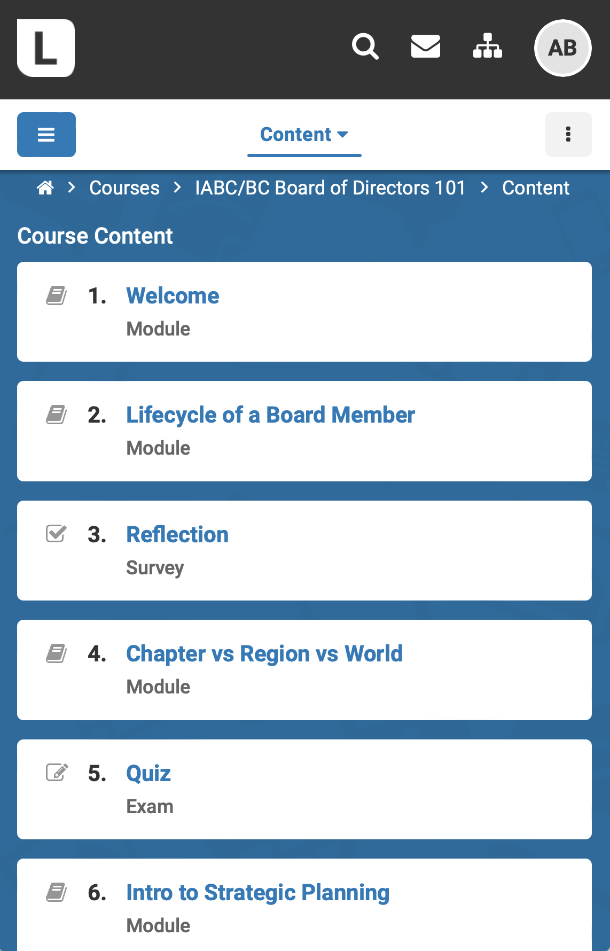
The IABC/BC Board of Directors 101 onboarding course is currently divided into 13 modules, with room to grow.
Modules

Slide 26
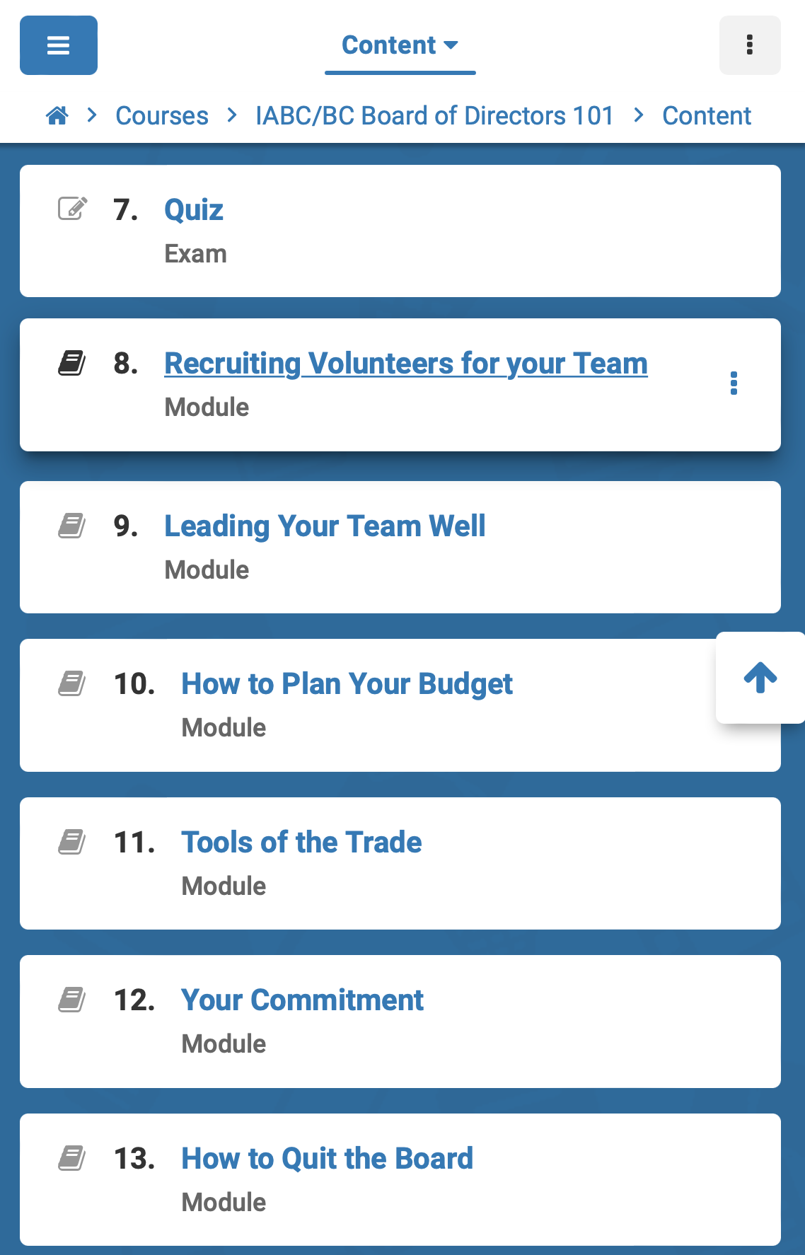
Content includes a mix of educational material and interactive assessments.
Modules, Cont’d.

Slide 30
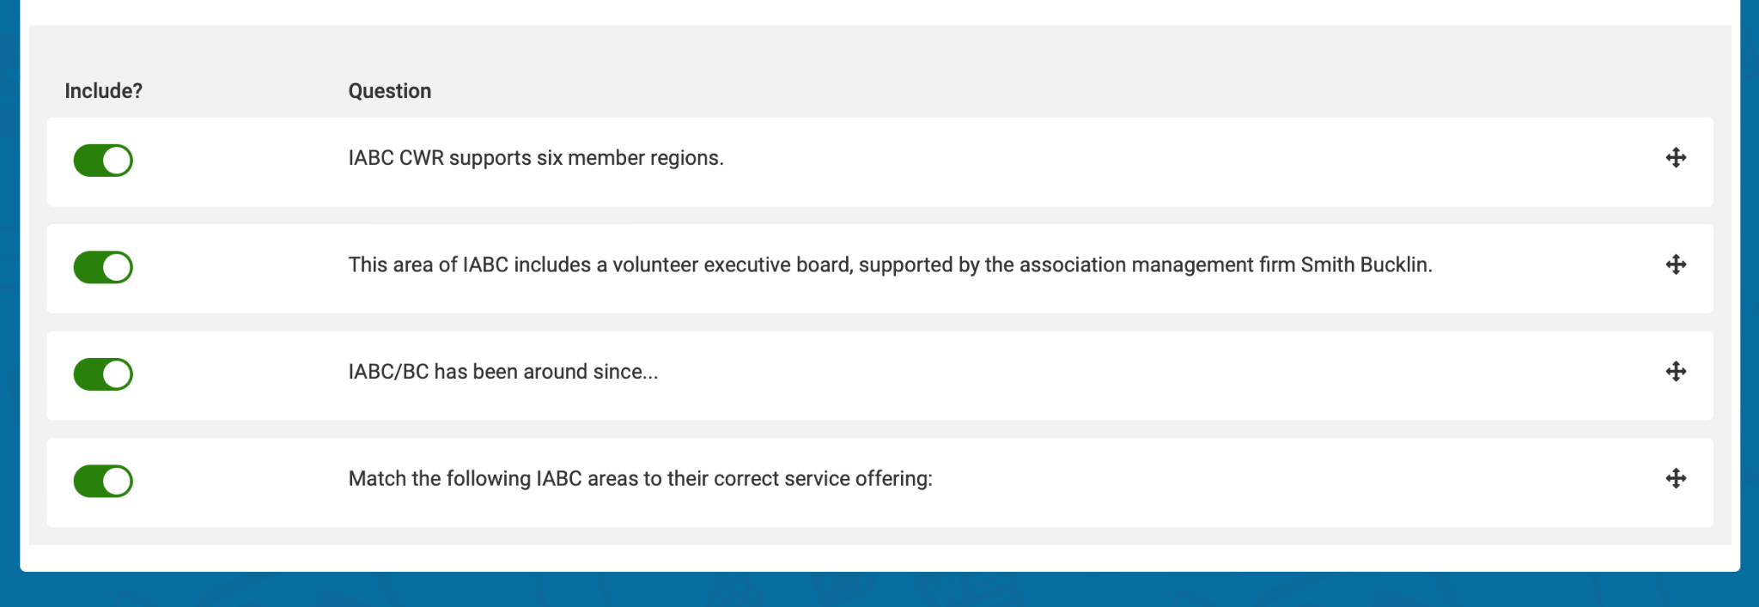

Slide 31
Volunteer Appreciation
And Retention

Slide 32
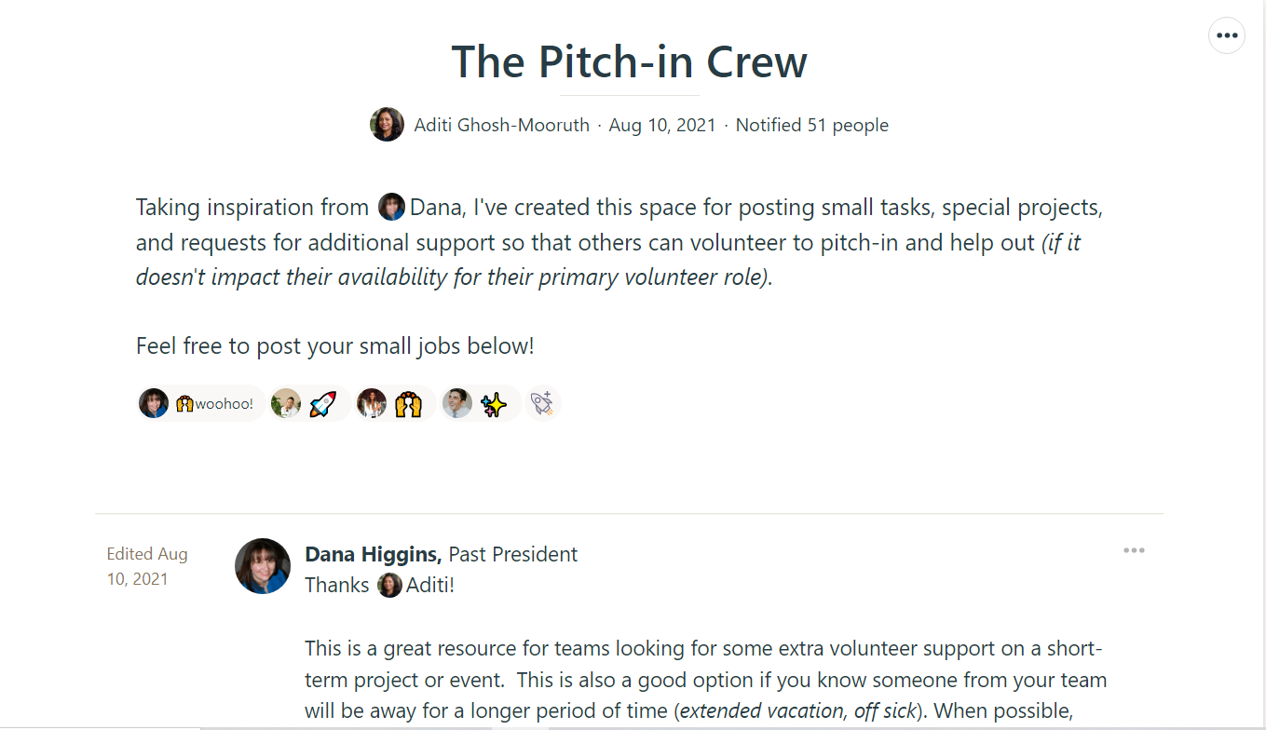

Slide 33
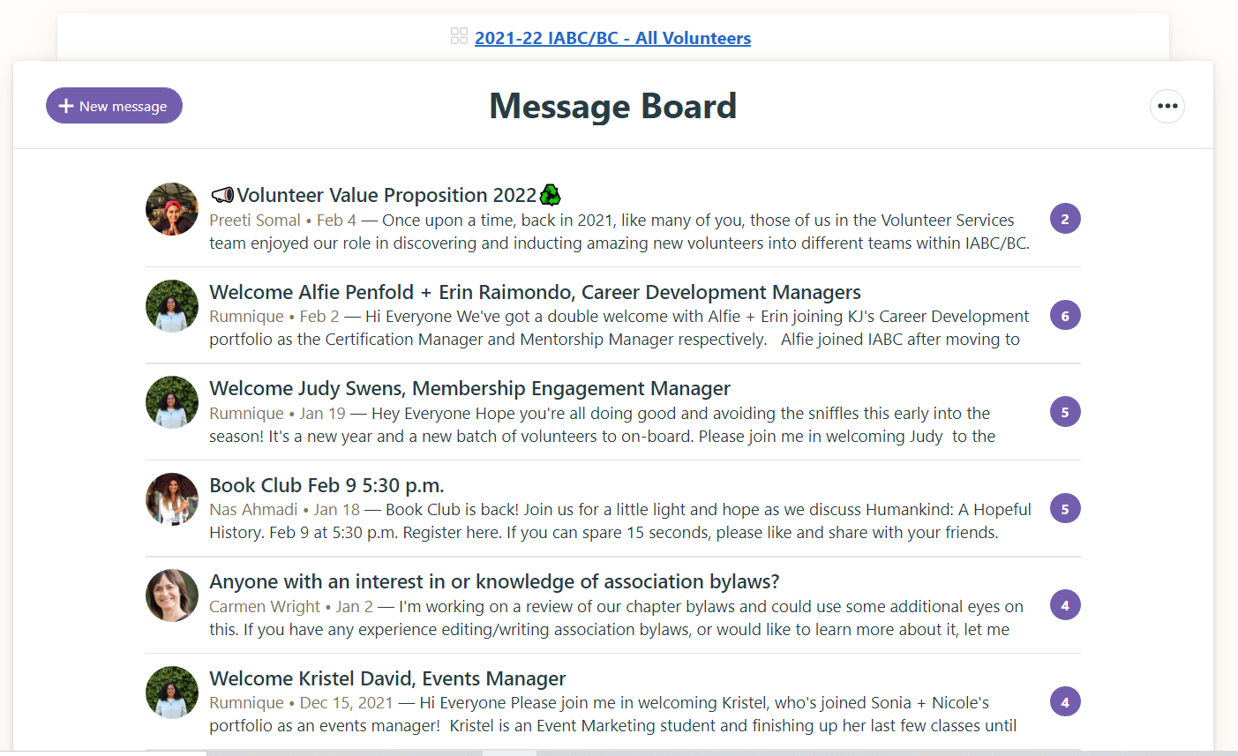
All Volunteers Basecamp Space

Slide 34
Board Buddies
Different organizational and work style
Formalizing portfolio appreciation budget
Reframing challenging conversations
Photo credit Justin Veenema (Unsplash)

Slide 37
Volunteer appreciation event - National Volunteer Week
Meet and celebrate with all volunteers
Recognize their contributions to the Chapter

Slide 38
Succession Planning

Slide 39
Proxies for Board meetings
Save everything (early and always)
Associate Directors
Previous Presidents
Expanded reach
Photo credit - Braden Collum (Unsplash)

Slide 40
How will you support engagement this month?

Slide 41
Credit Tim Mossholder (Unsplash)
Notes:
Q&A with audience

