Slide 1



Recruit and Engage Leaders for Success
Arlene Amitirigala
VP, Special Interest Groups
IABC/Toronto
Jacob R. Robinson
Managing Director, SCC
IABC/Toronto

Slide 2
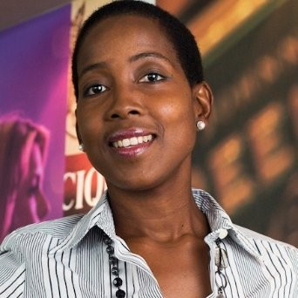


Introductions & Agenda
Our backgrounds and IABC journeys
Today’s Agenda
Notes:
10 mins
Tell our story and involvement with IABC
Talk about the session, how it will help you, and the flow today

Slide 3


The PIC Experience
Create vision
Build relationships
Be of service
Celebrate wins
Give freedom to succeed
Notes:
12 minutes

Slide 4

Networking: Round One
Join a breakout room.
Discuss the 5-point star that was shared.
What resonated most with you?
How can you incorporate this in your leadership?

Slide 5

The Student Communicators Circle
Create value
Delegate tasks
Explore interest areas
Authenticity is King
Have 1:1 conversations
Notes:
12 minutes

Slide 6
Networking: Round Two
Join a breakout room.
Discuss the 5-point star that was shared.
What resonated most with you?
How can you incorporate this in your leadership?

Slide 7

The Power of the Elevator Pitch
Notes:
8 mins
It all starts with ‘WHY’

Slide 8

Develop your Elevator Pitch
What is your focus and WHY?
Highlight key messages
Less than minute to deliver
Be memorable
Notes:
4 mins
Talk about why IABC, why this role exists
Talk about the what – what will they do in this role
Talk about how it will benefit them and others – WIIFM rules
An Elevator pitch:
Helps to secure commitment and action. Be memorable in terms of how you deliver it and how the receiver receives it.
Written to be said not read
Consider ‘writing for radio’ as a technique – lots of radio experts in this room!
We remember things in ‘threes’ so try and stick to three bullets per point
Try and paint a picture of what success will look like
(you might like to consider a metaphor)
Summarise your most important messages
Use simple language – avoid jargon and acronyms, make it real
Practice delivering it

Slide 9
Wrap Up
Questions?
Onwards and upwards!
Notes:
4 mins

